Slide 1
Overall OSHA Update
Jim Shelton, CAS
Houston North Area Office

Slide 2
Houston Fatality/Catastrophe Events
*Partial Year FY 2019 (Oct 1, 2018 – Sep 24, 2019) Estimate

Slide 3
Houston Area Fatal Incidents by Month
* FY 19 is a partial year to Sept 24th

Slide 4
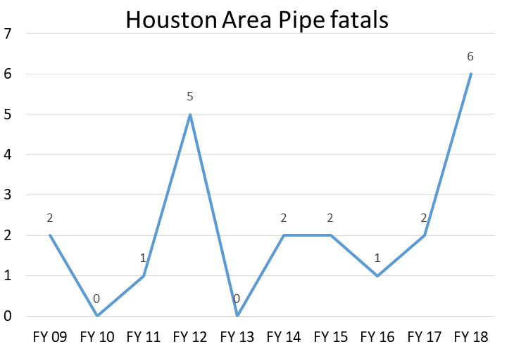
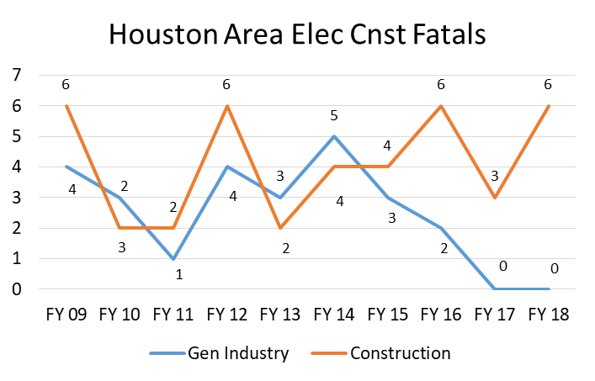
FY 18 the Trends Were….
Forklifts with six fatal incidents
In FY 19 we’ve five incidents
Six pipe related incidents
In FY 19 we had no pipe related fatal incidents
Six electrical related incidents in construction
In FY 19 we’ve had five incidents

Slide 5
FY 19* Trends Appear to Be
Landscapers are having a bad year:
Trimming trees and fell approximately 30‘
Heat related death with body temperature of 109°
Two died inside hydro-mulch tank
Trimming trees and fell approximately 15’
Trimming trees and 8' long section fell on worker
Lightning struck employee and a nearby tree
FY 17 will be the second worst year for landscaping incidents with five fatal events. There were no fatal incidents in FY 18

Slide 6
FY 19* Trends Appear to Be
Electrical fatalities in construction (again)
Aerial lift contacted overhead power lines
Boom truck energized by overhead power line
Struck by lightning
Electrocuted when they cut energized wire
Electrocuted installing a/c unit outside a house

Slide 7
FY 19* Trends Appear to Be
Electrical fatalities in general industry
There has been very few electrical incidents in general industry the last few years. In FY 19 we have had three fatal events (plus the lightning incident in landscaping)
Changing out fluorescent lamps was shocked and fell 6' striking his head on the floor
Electric furnace operator electrocuted near coils
Resetting deep fryer and reached behind it to reset and contacted an energized line

Slide 8
FY 19* Trends Appear to Be
Forklift fatalities (again)
Employee crushed working from a basket attached to the forks of a rough terrain forklift
Telescopic handler tipped over
Crushed when forklift rolled down trailer ramp
Operator fell approximately 32’ from elevated rack
Forklift operator ran over employee he didn’t see

Slide 9
FY 20 Region VI Emphasis Programs
Fall Hazards in Non-Construction Industries
Safety & Health Hazards in the Manufacture of Fabricated Metal Products
High Noise in Manufacturing Industries
Heat Illnesses
Grain Handling Facilities
Poultry Processing Facilities
Upstream Oil and Gas Industry
Health Hazards in the Healthcare Industry
Fertilizer Grade Ammonium Nitrate (FGAN) and Agricultural Anhydrous Ammonia Facilities
Construction
Cranes in Construction

Slide 10
Recordkeeping vs. Reporting
‘Recording’
Death
Days away from work
Restricted work activity
Transfer to another job
Medical treatment beyond first aid
Loss of consciousness
Significant injury or illness diagnosed by a PLHCP
‘Reporting’
Fatalities (w/in 8 hours)
Hospitalizations, amputations, or loss of an eye (w/in 24 hours)
eReporting (annually for designated industries and establishments)

Slide 11
Respirable Crystalline Silica
OSHA is soliciting for information and comments by October 14, 2019 on:
Any additional engineering and work practice control methods for tasks on Table 1
Any other construction equipment and tasks that should be added to Table 1
Whether to revise paragraph (a)(3) of the general industry/maritime standard to broaden the circumstances under which they could comply with Table 1 of the silica standard for construction

Slide 12
Respirable Crystalline Silica
A Compliance Directive and National Emphasis Program (NEP) for silica should be out the beginning of the fiscal year
Targeted inspection in top construction and general industry sectors with traditionally high silica exposures
There will be a 90 day outreach period prior to inspections. HNAO will be offering several workshops after the NEP is issued

Slide 13
Other Things to Watch For
OSHA sent out approximately 30,000 notifications to facilities with high DART rates based on the 2017 eReporting submittals
More than 235,000 OSHA 300A forms were submitted
The 2016 data was used for the SST 16 high DART rate employers
Updated amputation NEP

Slide 14
Excavation Safety
By September 30, 2019 increase excavation hazards abated by 10% compared to FY17 through inspections and compliance assistance
Updated National Emphasis Program for trenching and excavations issued Oct 1, 2018
National Trench Safety Stand Down June 17-21
Emphasis will continue into 2020

Slide 15
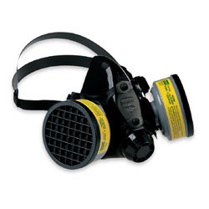
OSHA Regulatory Agenda
Beryllium
Reviewing comments from Dec 2018 General Industry proposed update; updated proposal for construction and shipyards with OMB
Respirator Fit testing
Considering new abbreviated respirator fit testing method; final rule with OMB for review
Lockout/Tagout
Reviewing comments from RFI related to computer-based controls and robotics

Slide 16
OSHA Regulatory Agenda
Leading Indicators of Occupational Safety and Health
Recently published guidance; plan to hold stakeholder meeting in Nov to encourage use amongst small and medium sized businesses
Early Phase Rulemakings
Tree Care – plan to initiate this fall
Workplace Violence in Healthcare and Social Assistance – planned for later this year

Slide 17
Multi-Employer Worksites
The 5th Circuit upheld OSHAs ability to issue citations under the multi-employer citation policy
Covers Texas, Louisiana, and Mississippi
CPL 2-00.124 Multi-Employer Citation Policy
Controlling Employer
Exposing Employer
Correcting employer
Creating Employer

Slide 18
Multi-Employer Worksites
An employer may have multiple roles
Only exposing employers can be cited for General Duty Clause violations
The measures that a controlling employer must take to satisfy its duty to exercise reasonable care to prevent and detect violations is less than what is required of an employer with respect to protecting its own employees

Slide 19
Multi-Employer Worksites
Creating Employer – The employer that caused a hazardous condition that violates an OSHA standard
An employer must not create a violative condition and is citable even if only employees exposed are of other employers

Slide 20
Multi-Employer Worksites
Exposing Employer – An employer whose own employees are exposed to the hazard
If the hazardous condition was created by another employer the exposing employer is citable if:
Knew of the hazardous condition or failed to exercise due diligence to discover it
Failed to take steps consistent with its authority to protect its employees

Slide 21
Multi-Employer Worksites
Correcting Employer – Employer engaged in a common undertaking, on the same worksite, as the exposing employer and is responsible for correcting a hazard
Usually occurs where an employer is given responsibility of installing and/or maintaining particular safety/health equipment or devices
Must exercise reasonable care in preventing and discovering violations and must meet its obligations of correcting the hazard

Slide 22
Multi-Employer Worksites
Controlling Employer – Employer who has general supervisory authority over the worksite including the power to correct safety and health violations itself or require other to correct them. Control can be established by contract, in the absence of explicit contractual provisions, by exercise of control in practice
A controlling employer must exercise reasonable care to prevent and detect violations on the site

Slide 23
Multi-Employer Worksites
The extent of the measures that a controlling ER must implement to satisfy this duty of reasonable care is less than what is required of an employer with respect to protecting its own EEs. This means they are not normally required to inspect for hazards as frequently or to have the same level of knowledge of the applicable standards or trade expertise as the employer hired

Slide 24
Multi-Employer Worksites
Factors Related to Reasonable Care:
The scale of the project
Nature and pace of work including frequency with which the numbers or types of hazards change as the work progresses
How much the controlling ER knows both about the safety history and safety practices of the ER it controls and the ER’s level of expertise

Slide 25
Multi-Employer Worksites
The most important indicator of an effective safety and health effort by the other ER is a consistently high level of compliance. Other indicators include:
Effective, graduated system of enforcement for non-compliance coupled with regular jobsite safety meetings and safety training

Slide 26
Multi-Employer Worksites
Evaluating Reasonable Care:
In evaluating whether reasonable care was exercised in preventing and discovering violations, consider if they:
Conducted periodic inspections of appropriate frequency
Implemented an effective system for promptly correcting hazards
Enforced compliance with an effective, graduated system of enforcement and follow-up inspections

Slide 27
Campaigns
National Fall Stand Down May 2020
Heat Illness Prevention May 2020
Trench Safety Stand Down June 2020
Safe + Sound Campaign August 20202

Slide 28
Questions?
Houston North Area Office
Joann Figueroa, Area Director
Jim Shelton, CAS
690 S. Loop 336 W., Suite 400
Conroe, TX 77304
shelton.james@dol.gov
Keep up to date with the Houston North Area Office email list. Contact Jim Shelton at the above email

Slide 29
Disclaimer
This information has been developed by an OSHA Compliance Assistance Specialist and is intended to assist employers, workers, and others as they strive to improve workplace health and safety. While we attempt to thoroughly address specific topics [or hazards], it is not possible to include discussion of everything necessary to ensure a healthy and safe working environment in a presentation of this nature. Thus, this information must be understood as a tool for addressing workplace hazards, rather than an exhaustive statement of an employer’s legal obligations, which are defined by statute, regulations, and standards. Likewise, to the extent that this information references practices or procedures that may enhance health or safety, but which are not required by a statute, regulation, or standard, it cannot, and does not, create additional legal obligations. Finally, over time, OSHA may modify rules and interpretations in light of new technology, information, or circumstances; to keep apprised of such developments, or to review information on a wide range of occupational safety and health topics, you can visit OSHA’s website at www.osha.gov.

