Slide 1
Let’s Talk about Excavations…
Jim Shelton, CAS
Houston North Area Office

Slide 2
Why We Have Excavation Rules
April 16, 2019 Headline “Equipment World”
OSHA investigating 5 trench deaths occurring in less than 10 days
April 6th Dalbert Burton working on a residential sewer installation in Sugarcreek Township, OH died when the 14’ deep trench he was in collapsed
April 8th Christopher McDonald died in a 20’ deep trench in Marysville, OH relocating a water line when the unshored trench collapsed
Rescue workers respond to a trench collapse in Spencer, Tennessee, that killed a city utility worker.
Photo credit: Putnam County Rescue Squad

Slide 3
Why We Have Excavation Rules
April 10th Javier “Jay” Ortega Jr. and Arcenio Carrillo died when a 6’-7’ trench without shoring or other protective devices collapsed
April 2nd Mickey Fisher was working a trench to repair a pipe when the trench collapsed
11 Children will grow up without a father
2 Children will grow up without a grandfather
2 Wives lost their husband
1 Fiancé won’t see her wedding
1 Child will never meet their father
Larry Meyer, Leslie Thompson
The Argus Observer

Slide 4
Why We Have Excavation Rules
So I look at my email this morning and what do I see?
Two construction workers die in trench collapse in Windsor
Fire rescue personnel worked into the night Tuesday to recover the bodies.
By KIERAN NICHOLSON | knicholson@denverpost.com | The Denver Post
Two workers died when a 15-foot deep trench collapsed on them Tuesday in Windsor.
Windsor Severance Fire Rescue via Facebook

Slide 5
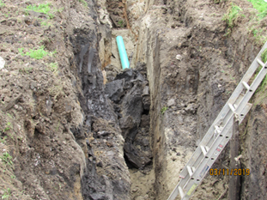
Why We Have Excavation Rules
Houston close calls:
February 2019 workers removed the upper braces from between the plywood shoring and entered the trench to remove the lower braces when a section of wall about 35’ in length collapsed. The dirt pushed one side of the shoring over forming a tee pee shape and the workers were able to crawl out without serious injury
March 2019 a section of trench collapsed and the workers continued working. OSHA inspectors arrived and another section of the trench collapsed. Fortunately the workers were now out of the trench.

Slide 6
Why We Have Excavation Rules
Trench Dimensions: 8’ deep, 12’ long, 11’ wide, vertical walls. Employees were boring under the roadbed to install a 6” sewer line tap on south end of trench
The ground surface on the road side of the trench has no fissure. Time12:42 PM.

Slide 7
Why We Have Excavation Rules
The ground surface on the road side of the trench begins to fissure. Time : 1:05:50 PM.
The ground surface/wall on the road side of the trench collapsing. Time : 1:06:16 PM.

Slide 8
Why We Have Excavation Rules
Collapsed wall. The portion of the wall that fell was15” wide by 9’ long by 5’ deep. Weight of the dirt was conservatively calculated to be 6,187 pounds… just over 3 tons
It took 26 seconds from the appearance of the fissure to the collapse of the wall. The employees would have been struck-by the collapsed wall while installing the sewer line.

Slide 9
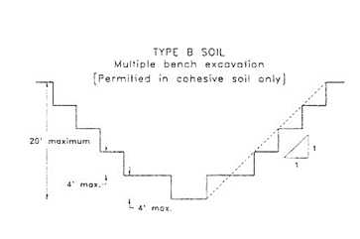
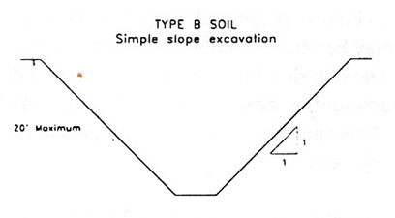
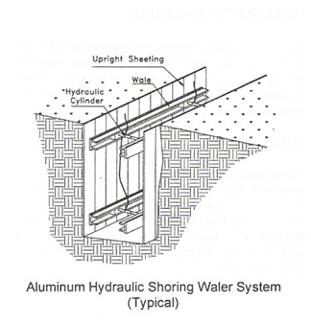
Fatalities Can be Prevented
Employees in excavations must be protected from cave-ins by either…
Sloping
Stepping/Benching
Shoring
Trench Box

Slide 10
Fatalities Can be Prevented
Safety doesn’t have shortcuts. You might save a minute but may lose your life

Slide 11
Safety Quiz
An excavation requires protection from cave-in at what depth?
4 Feet
5 Feet
6 Feet
10 Feet
5 Feet
1926.652(a)(1)(ii) Unless it’s in stable rock or an examination by a competent person determines an excavation less than 5 feet doesn’t pose a cave-in hazard

Slide 12
Safety Quiz
What is a competent person considered in an OSHA standard?
One who is capable of identifying existing and predictable hazards in the surroundings or working conditions which are unsanitary, hazardous, or dangerous to employees and has the authorization to take prompt corrective action to eliminate them
1926.650(b)

Slide 13
Safety Quiz
A means of egress from trench excavations is required when the depth of the excavation is ____ feet deep or more in depth?
3 Feet
4 Feet
5 Feet
6 Feet
4 Feet
1926.651(C)(2) and must have no more than 25 feet of lateral travel to reach

Slide 14
Safety Quiz
The estimated location of utility installations such as sewer, telephone, fuel, electric, water lines that may reasonably be expected to be encountered must be determined prior to opening an excavation
True
False
True
1926.651(b)

Slide 15
Safety Quiz
No
The ratio is 1-1/2 : 1 but there is no benching chart for benching Type ‘C’ soils. The chart shows a simple slope Appendix B, B-1.3
Would a 1-1/2 : 1 benched ratio be acceptable for a Type ‘C’ soil?
No
The ratio is 1-1/2 : 1, not 1 : 1
Yet how many excavation do we see one bucket down and one bucket over?
Would a 1 : 1 benched ratio be acceptable for a Type ‘C’ soil?

Slide 16
Safety Quiz
Trench excavations require a daily inspection by a competent person
True
False
True
1926.651(k)(1) Prior to the start of work and as needed throughout the shift, after rain storms or other hazard that occurs when there is employee exposure anticipated

Slide 17
Trenching excavation fatalities and injuries can be prevented

Slide 18
FY 18 MFC Fed OSHA Subpart P
Standard | Cited | Narrative
1926.652(a)(1) | 434 | Each employee in an excavation shall be protected from cave-ins by an adequate protective system designed in accordance with paragraph (b) or (c) of this section except…
1926.651(c)(2) | 178 | A stairway, ladder, ramp or other safe means of egress shall be located in trench excavations that are 4 feet (1.22 m) or more in depth so as to require no more than 25 feet (7.62 m) of lateral travel for employees
1926.651(k)(1) | 138 | Daily inspections of excavations, the adjacent areas, and protective systems shall be made by a competent person for evidence of a situation that could result in possible cave-ins, indications of failure of protective systems, hazardous atmospheres, or other hazardous conditions. An inspection shall be conducted by the competent person prior to the start of work and as needed throughout the shift. Inspections shall also be made after every rainstorm or other hazard increasing occurrence. These inspections are only required when employee exposure can be reasonably anticipated

Slide 19
FY 18 MFC Fed OSHA Subpart P
Standard | Cited | Narrative
1926.651(j)(2) | 115 | Employees shall be protected from excavated or other materials or equipment that could pose a hazard by falling or rolling into excavations. Protection shall be provided by placing and keeping such materials or equipment at least 2 feet (.61 m) from the edge of excavations, or by the use of retaining devices that are sufficient to prevent materials or equipment from falling or rolling into excavations, or by a combination of both if necessary
1926.651(k)(2) | 55 | Where the competent person finds evidence of a situation that could result in a possible cave-in, indications of failure of protective systems, hazardous atmospheres, or other hazardous conditions, exposed employees shall be removed from the hazardous area until the necessary precautions have been taken to ensure their safety.
1926.651(h)(1) | 28 | Employees shall not work in excavations in which there is accumulated water, or in excavations in which water is accumulating, unless adequate precautions have been taken to protect employees against the hazards posed by water accumulation. The precautions necessary to protect employees adequately vary with each situation, but could include special support or shield systems to protect from cave-ins, water removal to control the level of accumulating water, or use of a safety harness and lifeline.

Slide 20
FY 18 MFC Fed OSHA Subpart P
Standard | Cited | Narrative
1926.651(i)(3) | 19 | Sidewalks, pavements, and appurtenant structure shall not be undermined unless a support system or another method of protection is provided to protect employees from the possible collapse of such structures
1926.652(b)(2) |  | Maximum allowable slopes, and allowable configurations for sloping and benching systems, shall be determined in accordance with the conditions and requirements set forth in appendices A and B to this subpart
1926.651(j)(1) | 13 | Adequate protection shall be provided to protect employees from loose rock or soil that could pose a hazard by falling or rolling from an excavation face. Such protection shall consist of scaling to remove loose material; installation of protective barricades at intervals as necessary on the face to stop and contain falling material; or other means that provide equivalent protection
1926.651(d) | 12 | Employees exposed to public vehicular traffic shall be provided with, and shall wear, warning vests or other suitable garments marked with or made of reflectorized or high-visibility material

Slide 21
FY 18 MFC Fed OSHA Subpart P
Standard | Cited | Narrative
1926.651(b)(4) | 12 | While the excavation is open, underground installations shall be protected, supported or removed as necessary to safeguard employees.
1926.651(e) | 12 | No employee shall be permitted underneath loads handled by lifting or digging equipment. Employees shall be required to stand away from any vehicle being loaded or unloaded to avoid being struck by any spillage or falling materials.
In FY 18 Fed OSHA issued approximately 1,157 citations for violations of Subpart P with proposed penalties of $8.2 million

Slide 22
BLS Fatalities by Event or Exposure

Slide 23
Trenching and Excavation NEP
By September 30, 2019 increase excavation hazards abated by 10% compared to FY17 through inspections and compliance assistance
Updated National Emphasis Program for trenching and excavations issued Oct 1, 2018
National Trench Safety Stand Down June 17-21

Slide 25
Questions?
Houston North Area Office
Joann Figueroa, Area Director
Jim Shelton, CAS
690 S. Loop 336 W., Suite 400
Conroe, TX 77304
shelton.james@dol.gov
Disclaimer: This information has been developed by an OSHA Compliance Assistance Specialist and is intended to assist employers, workers, and others as they strive to improve workplace health and safety. While we attempt to thoroughly address specific topics [or hazards], it is not possible to include discussion of everything necessary to ensure a healthy and safe working environment in a presentation of this nature. Thus, this information must be understood as a tool for addressing workplace hazards, rather than an exhaustive statement of an employer’s legal obligations, which are defined by statute, regulations, and standards. Likewise, to the extent that this information references practices or procedures that may enhance health or safety, but which are not required by a statute, regulation, or standard, it cannot, and does not, create additional legal obligations. Finally, over time, OSHA may modify rules and interpretations in light of new technology, information, or circumstances; to keep apprised of such developments, or to review information on a wide range of occupational safety and health topics, you can visit OSHA’s website at www.osha.gov.

